Slide 1


Student Details
Name :
MALASANI SREEKRISHNACHAITHANYADHANUSHYADAV
Email ID :
dhanushyadav4578@gmail.com
College Name :
Pragati Engineering College
College State :
Andhra Pradesh
Internship Domain :
Cyber Security
Internship Start to End Date :
7 June 2023 to 23 July 2023

Slide 2
PROJECT TITTLE: Dos attack using NS2 tool PROBLEM STATEMENT: The objective of this project is to simulate and analyze the effects of a Denial-of-Service (DOS) attack on a network using the NS2 tool. The project involves installing NS2 on Ubuntu or any Linux operating system, creating a network topology using the Tcl language, and executing a DOS attack simulation. The simulation aims to emulate the impact of a DOS attack on network performance, network packet loss, and latency. The main problem to address in this project is to design and implement an efficient simulation environment that accurately models a DOS attack and its consequences on a network. The simulation should replicate various types of DOS attacks, such as TCP SYN flood, ICMP flood, or UDP flood attacks, and measure their impact on network resources. The project will require developing or utilizing existing NS2 scripts to configure the network topology, simulate the DOS attack, and record the output data obtained during the simulation. The output data will be stored in a file for subsequent analysis
02

Slide 3
01
In this presentation, we will be discuss about our
project DOS attack and its value proposition.
Agenda.
02
We will also talk about how we customized the project to make it our own, as well as the modelling and results of the project.
03

Slide 4
01
Our project focuses on simulating and analyzing DoS attacks using the NS2 (Network Simulator 2) tool.
Project Overview.
02
NS2 is a widely-used open-source network simulation software that allows researchers and network engineers to study network protocols, simulate network scenarios, and evaluate the performance of various network components.
04

Slide 5
The End users of our project include:
01
Network administrators: To gain a deeper understanding of DoS attacks, their effects, and strategies to mitigate them.
Who are the END USERS of the Projects?
02
Security analysts: To assess the vulnerability of network infrastructures to DoS attacks and develop effective defense mechanisms.
03
Researchers: To analyze the impact of DoS attacks on network protocols and propose novel solutions.
05

Slide 6
01
Install Antivirus software with the latest updates.
Your Solution and Its Value Proposition.
02
Install a firewall and try to configure it with the most
recent updates to restrict traffic.
Apply filtering of emails to manage unwanted traffic.
03
Install IPS (Intrusion Prevention System) and IDS
(Intrusion Detection System) and configure it to drop
the malicious packets before entering into
the organization network
06

Slide 7
01
By using parrot OS I performed this project.
Installed NS2 and NAM.
How did you customize the project and make it your own ?
02
Developed TCL files to understand about network
topology.
03
Captured the packets to understand how the devices
communicate through internet.
07

Slide 8
01
Denial-of-Service (DoS) attacks are malicious
attempts to disrupt the availability of a computer
system, network, or service, making it inaccessible to its
intended users
Introduction to Denial-Of-Services(DOS) Attacks.
02
These attacks overwhelm the target system with a flood of illegitimate traffic or by exploiting vulnerabilities to exhaust its resources, causing service disruptions and impacting productivity.
08

Slide 9
01
TCP SYN flood is a type of DOS attack that exploits the TCP handshake process. The attacker sends multiple SYN packets to the target server, but never completes the handshake by sending an ACK packet. This causes the server to wait indefinitely for the ACK packet.
Types of DDOS Attacks.
02
UDP floods the target server with UDP packets. Unlike TCP, UDP does not have a handshake process, so the attacker can send as many packets as they want without waiting for a response.
03
HTTP flood targets web servers. The attacker sends a large number of HTTP requests to the server, often using multiple IP addresses to evade detection.
09

Slide 10
01
NS2 is a popular network simulator that allows researchers to simulate various network scenarios, including denial-of-service (DOS) attacks. With NS2, researchers can create virtual networks and test their responses to different types of attacks in a controlled environment.
NS2
02
NS2 has a wide range of capabilities, including the ability to simulate different types of traffic, network topologies, and protocols. It also has built-in tools for analyzing network performance and visualizing network traffic. These features make NS2 an ideal tool for studying the impact of DOS attacks on networks.
10

Slide 11
01
To set up an NS2 simulation of a DOS attack, We will need to first download and install NS2 on your computer.
Setting up an NS2 Simulation.
02
Once installed, we can begin creating your simulation by defining the network topology, configuring the nodes and links, and specifying the parameters for the attack.
03
This can be done using NS2's built-in scripting language, which allows you to create custom scenarios and test different attack strategies.
11

Slide 12

01
EXPLAIN THE NETWORK TOPOLOGY CODE –
Stable.tcl
Modelling.
02
EXPLAINING THE DOS CODE –
Doc.tcl
12

Slide 13
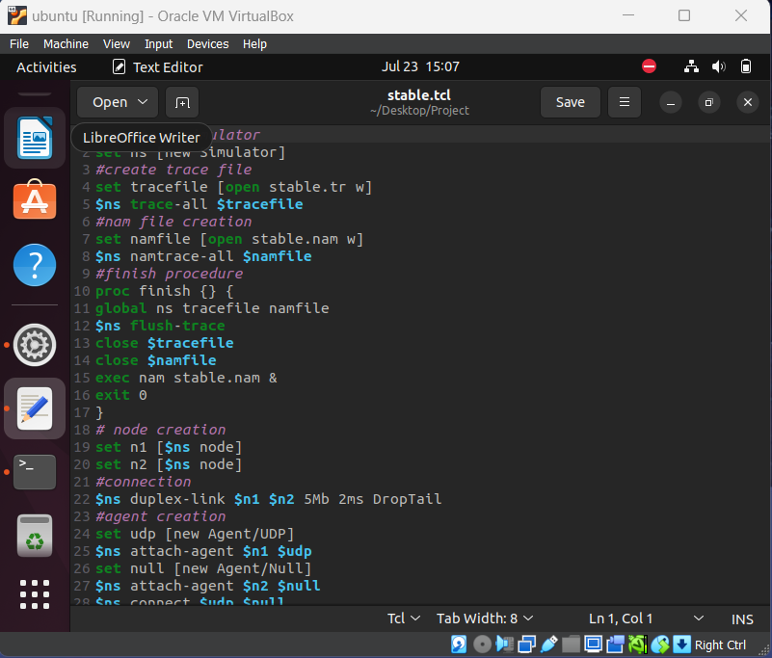
01
EXPLAIN THE NETWORK TOPOLOGY CODE – Stable.tcl
Setting up the Simulator:
The code initializes the NS2 simulator and creates trace and nam files to store simulation events.
Defining Nodes and Links:
Two nodes, n1 and n2, are created using the 'set' command to represent network entities.
The 'duplex-link' command establishes a network link between n1 and n2, defining the bandwidth, delay, and queuing discipline (DropTail).
Creating Agents:
A TCP agent is created using the 'new Agent/TCP' command.
The 'set' command is used to assign a class to the TCP agent.
The 'attach-agent' command attaches the TCP agent to node n1.
Creating a Sink Agent:
An Agent/TCPSink agent is created using the 'new Agent/TCPSink' command.
The 'attach-agent' command attaches the sink agent to node n2.
13

Slide 14
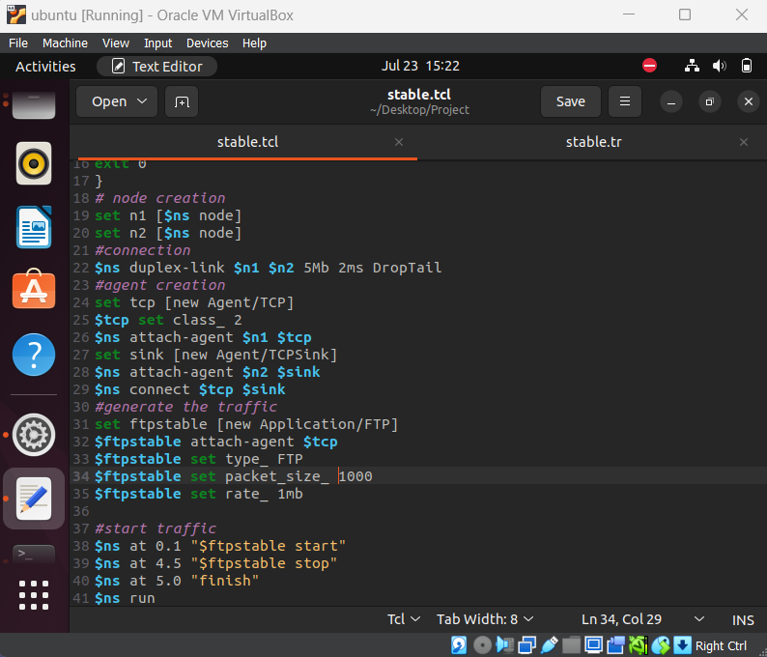
01
EXPLAIN THE NETWORK TOPOLOGY CODE – Stable.tcl
Connecting Agents:
The 'connect' command establishes a connection between the TCP agent and the sink agent.
Application Traffic:
An FTP application is created using the 'new Application/FTP' command.
The FTP application is attached to the TCP agent using the 'attach-agent' command.
Parameters such as type (FTP), packet size, and rate are set for the FTP application.
Scheduling Events:
The 'at' command is used to schedule events at specific times in the simulation.
At time 0.1 seconds, the FTP application is started using the 'start' method.
At time 4.5 seconds, the FTP application is stopped using the 'stop' method.
Finishing the Simulation:
The 'finish' procedure is defined to close the trace and nam files, ensuring that simulation events are saved.
The 'flush-trace' command ensures that all trace events are written to the trace file.
Finally, the trace and nam files are closed, and the 'nam' visualization tool is launched to view the simulation.
The simulation terminates gracefully with the 'exit' command.
14

Slide 15
EXPLAINING THE DOS CODE – Doc.tcl
02
Defining Network Nodes:
The code defines network nodes using the 'set' command, representing the server, clients, and an attacker.
Nodes are essential components in the simulation that can send and receive packets.
Connecting Nodes:
The 'duplex-link' command establishes network links between the nodes, specifying the bandwidth, delay, and queuing discipline (DropTail).
The 'queue-limit' command sets the queue size between the server1 and server2 nodes.
Creating Agents:
Agents are responsible for generating and handling network traffic.
The code creates UDP agents and attaches them to the client and attacker nodes.
Additionally, a Null agent is attached to the server2 node to discard incoming packets.
Traffic Generation:
The code defines CBR (Constant Bit Rate) traffic sources using the Application/Traffic/CBR module.
CBR sources generate traffic at specified packet sizes, rates, intervals, and attach them to UDP agents.
Three CBR traffic sources (cbr1, cbr2, cbr3) are created for client1, client2, and the attacker, respectively.
Starting and Stopping Traffic:
The 'at' command schedules the start and stop times for the traffic sources.
Traffic is started at different time instances for cbr1, cbr2, and cbr3.
The 'stop' method is called to stop the traffic from each traffic source at different time intervals.
Finishing the Simulation:
The 'finish' procedure is defined to close the trace and nam files, flush the trace buffer, and launch the nam visualization tool.
.
15
Notes:
https://unsplash.com/

Slide 16
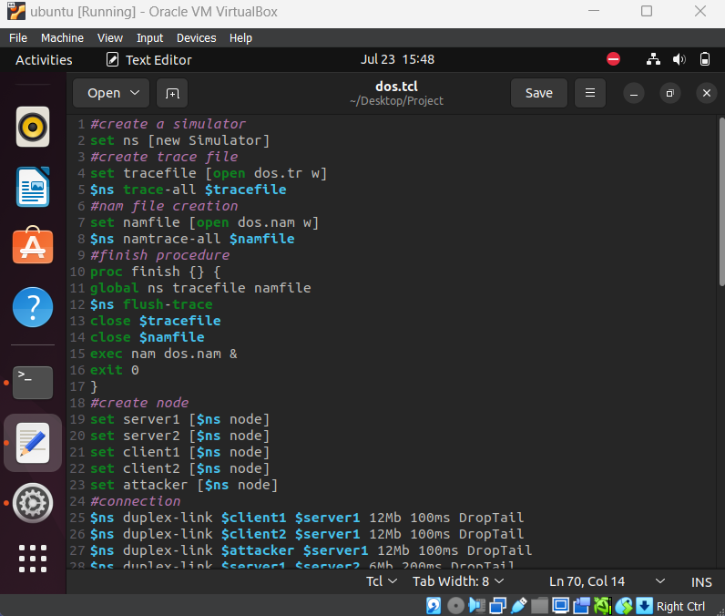
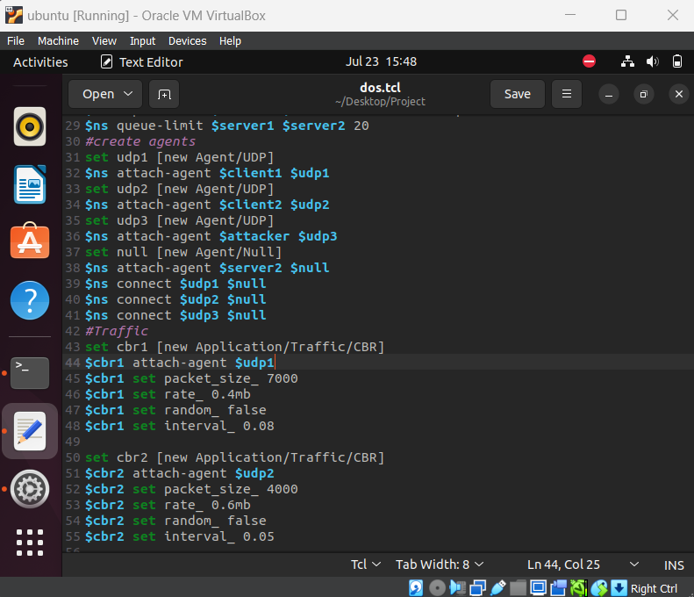
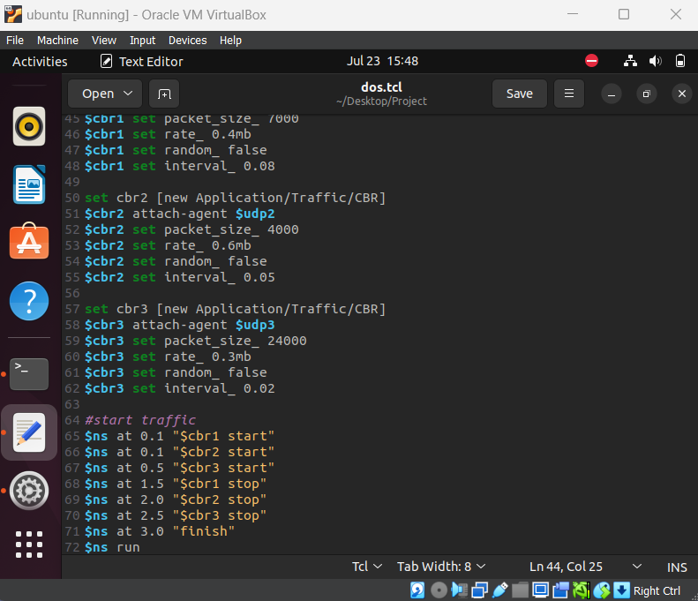
CODE
16

Slide 17

Execution
17

Slide 18
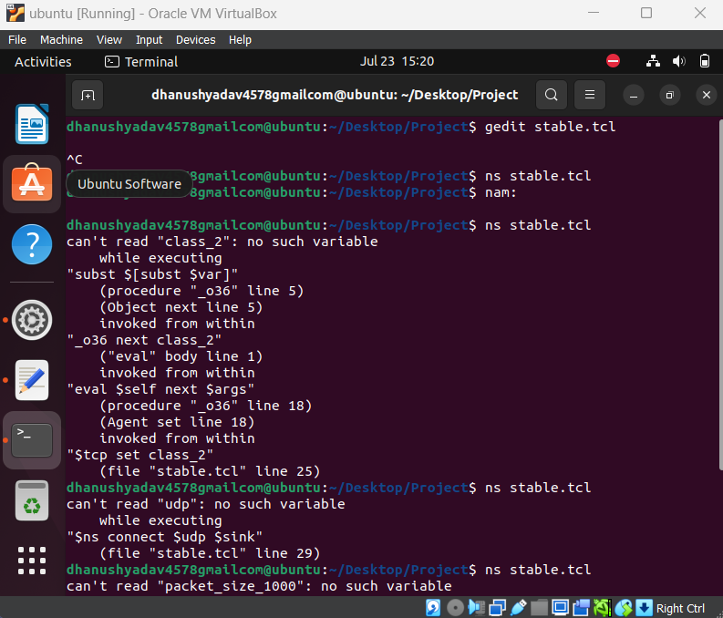
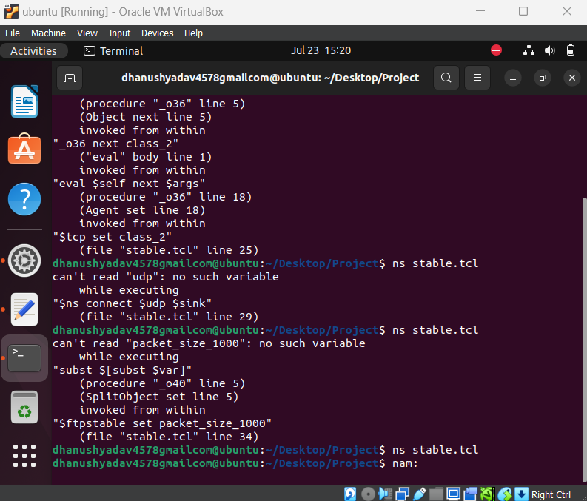
EXECUTING Stable.tcl IN TERMINAL
18

Slide 19
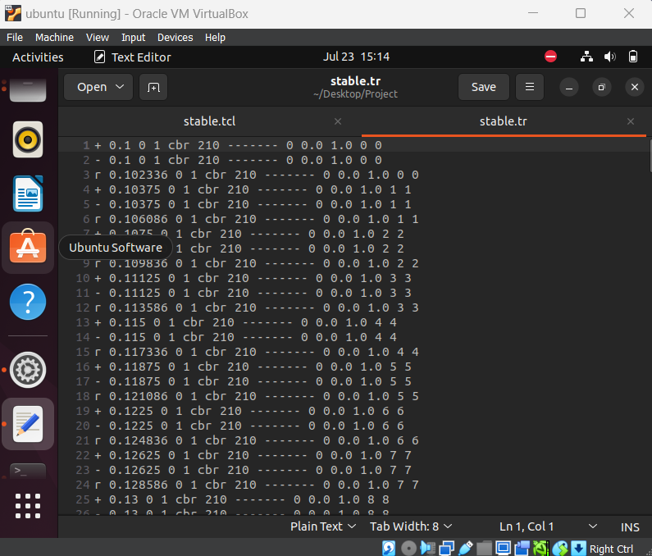
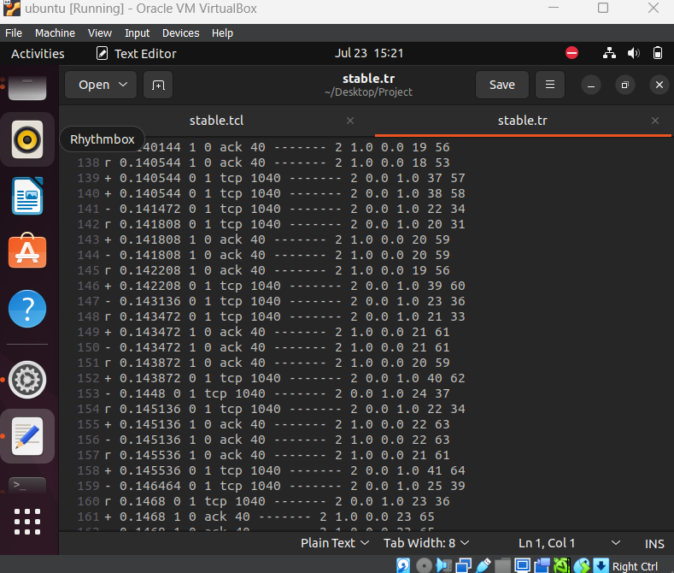
Stable.tr files
19

Slide 20
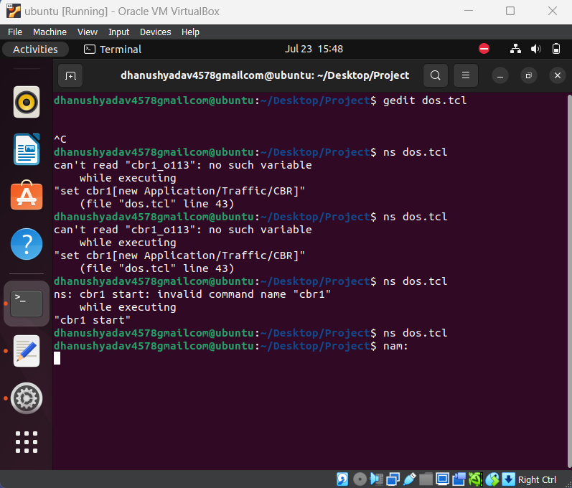
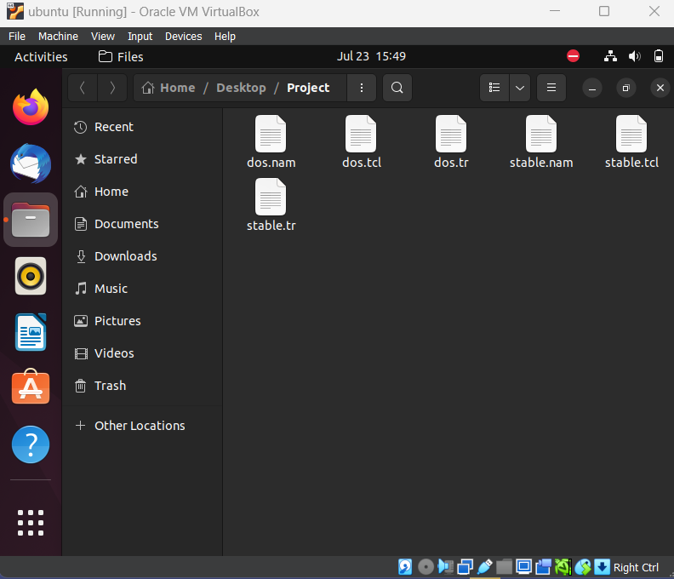
EXECUTING dos.tcl IN TERMINAL
20

Slide 21
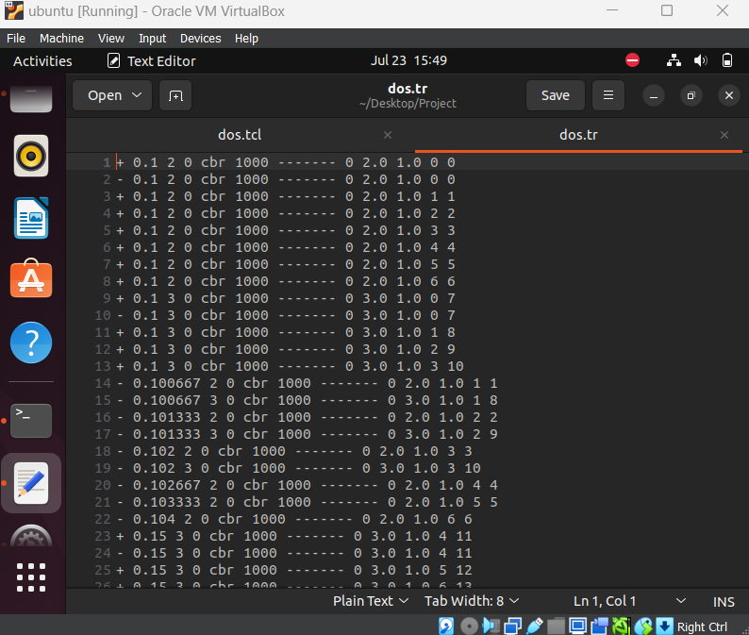
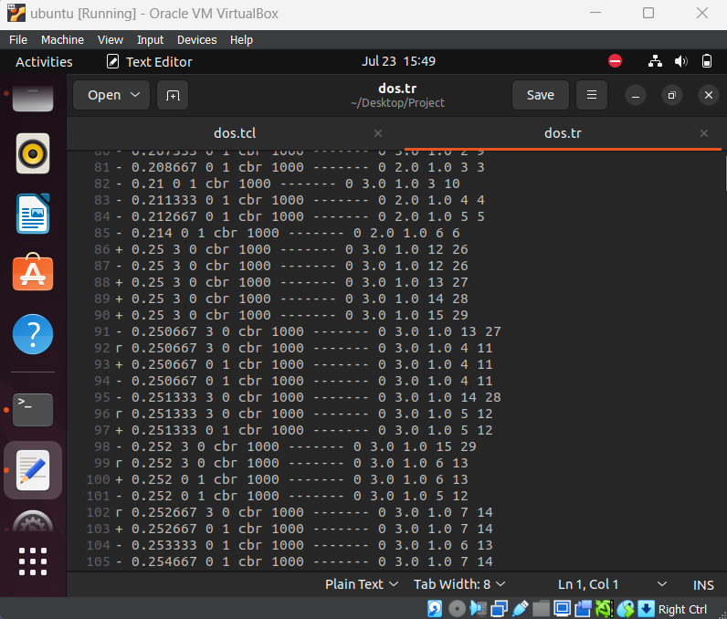
Dos.tr files
21

Slide 22
Results
The DOS attack simulation using the NS2 tool revealed the following key findings:
Impact on Network Performance:
Network Congestion: The attack led to increased congestion levels, resulting in packet loss and higher latency.
Packet Loss: The victim node experienced a significant packet loss rate due to the overwhelming SYN packets.
Latency: Average latency increased as the network became congested, causing delayed packet delivery.
Attack Intensity:
The attack rate of 1000 packets per second proved highly effective in overwhelming the victim node.
Higher attack rates could result in more severe network degradation and complete service unavailability.
22

Slide 23
Defense Mechanisms:
Effective defense measures, such as rate limiting, access controls, and traffic filtering, are essential to mitigate the impact of DOS attacks.
Implementing these measures can reduce packet loss, restore network performance, and protect against future attacks.
Anomaly Detection:
Analyzing network traffic patterns and monitoring performance metrics enables the timely detection of abnormal network behavior during DOS attacks.
Proactive anomaly detection aids in swift mitigation and minimizing the impact of DOS attacks.
Proactive Response:
Proactive incident response planning and training are crucial to minimize the impact of DOS attacks and ensure efficient recovery.
23

Slide 24
LINKS
Git hub profile :
https://github.com/Dhanushyadav23
Git repository :
https://github.com/Dhanushyadav23/Dos-Attack-using-NS2-Tool.git
LinkedIn profile :
https://www.linkedin.com/in/dhanushyadav/
IBM SkillBuild Profile:
dhanushyadav4578@gmail.com

Slide 25
THANK YOU

